Slide 1

Customer Billing System
Presented By :
Faizan Khan (1AM18MCA01)
Keshri Kishor (1AM19MCA74)

Slide 2
CUSTOMER BILLING SYSTEM
The application Customer Billing system has four main module –
Insertion, Deletion, Updation to database module – User friendly input screen.
Extracting from the database module –Attractive output screen.
Generate bill module – generate bill of purchased products.
Search facility system Module – Search for products and employees.

Slide 3
Project Design
The project design process is not a step by step. But still much of design work depends on knowledge and experience of the designs, when we start working on project design, we will face different types of problems. However, following considerations should be kept in mind during the project design phase:
Design Objectives –
The primary objective of the design of course, is to deliver the requirements as
specified already. In general the following design objectives kept in mind.
Practically –
The system must be stable and can be operated by people with average.
Efficiency –
This involves accuracy, timeliness, and comprehensiveness to the system output.

Slide 4
Cost –
It is desirable to aim for a system with a minimum cost subject to the condition thatit must satisfy all requirements & maintain maintenance.
Flexibility –
The system should be modifiable depending on the changing needs if the user. It should also be
portable to different computer system but not other than Windows OS.
Security –
This is very important aspect of the design and should cover areas of hardware reliability, fall back
procedures, physical security if the data. System design involves first logical design and then
physical construction of the system.

Slide 5
Introduction to Project
The project Customer Billing System is developed on visual basic language
The main objective of this project is to provide a friendly environment to maintain the details of products and employees and generate bill for customers.
What Language –Software Requirement
Visual Basic .Net Language
Integrated Development Environment –
The working environment in VB is often referred to as the Integrated Development Environment or IDE, because it integrates many different functions such as design, editing, compiling and debugging within a common environment. Since all our project are developed only in the IDE.

Slide 6
System Requirements of PC
Processor |  | Core 2 Dual / 4.3 above
RAM |  | 2 GB or above
HDD |  | 500 GB / 1 TB or above
OS |  | Window 7 or Later

Slide 7
4.2 DFD Level 1
+
{ Fig 4.2: DFD level 1 }
Data Flow Diagrams of Customer Billing System:
DFD Level 0
+
Admin/Emp
Customer Billing System
Cus Billing Sys
DFD LEVEL 0
DFD Level 1
Request
Request
Admin/ +
Admin / Customer Billing
Response
System
Response
Database
DFD LEVEL 1

Slide 8
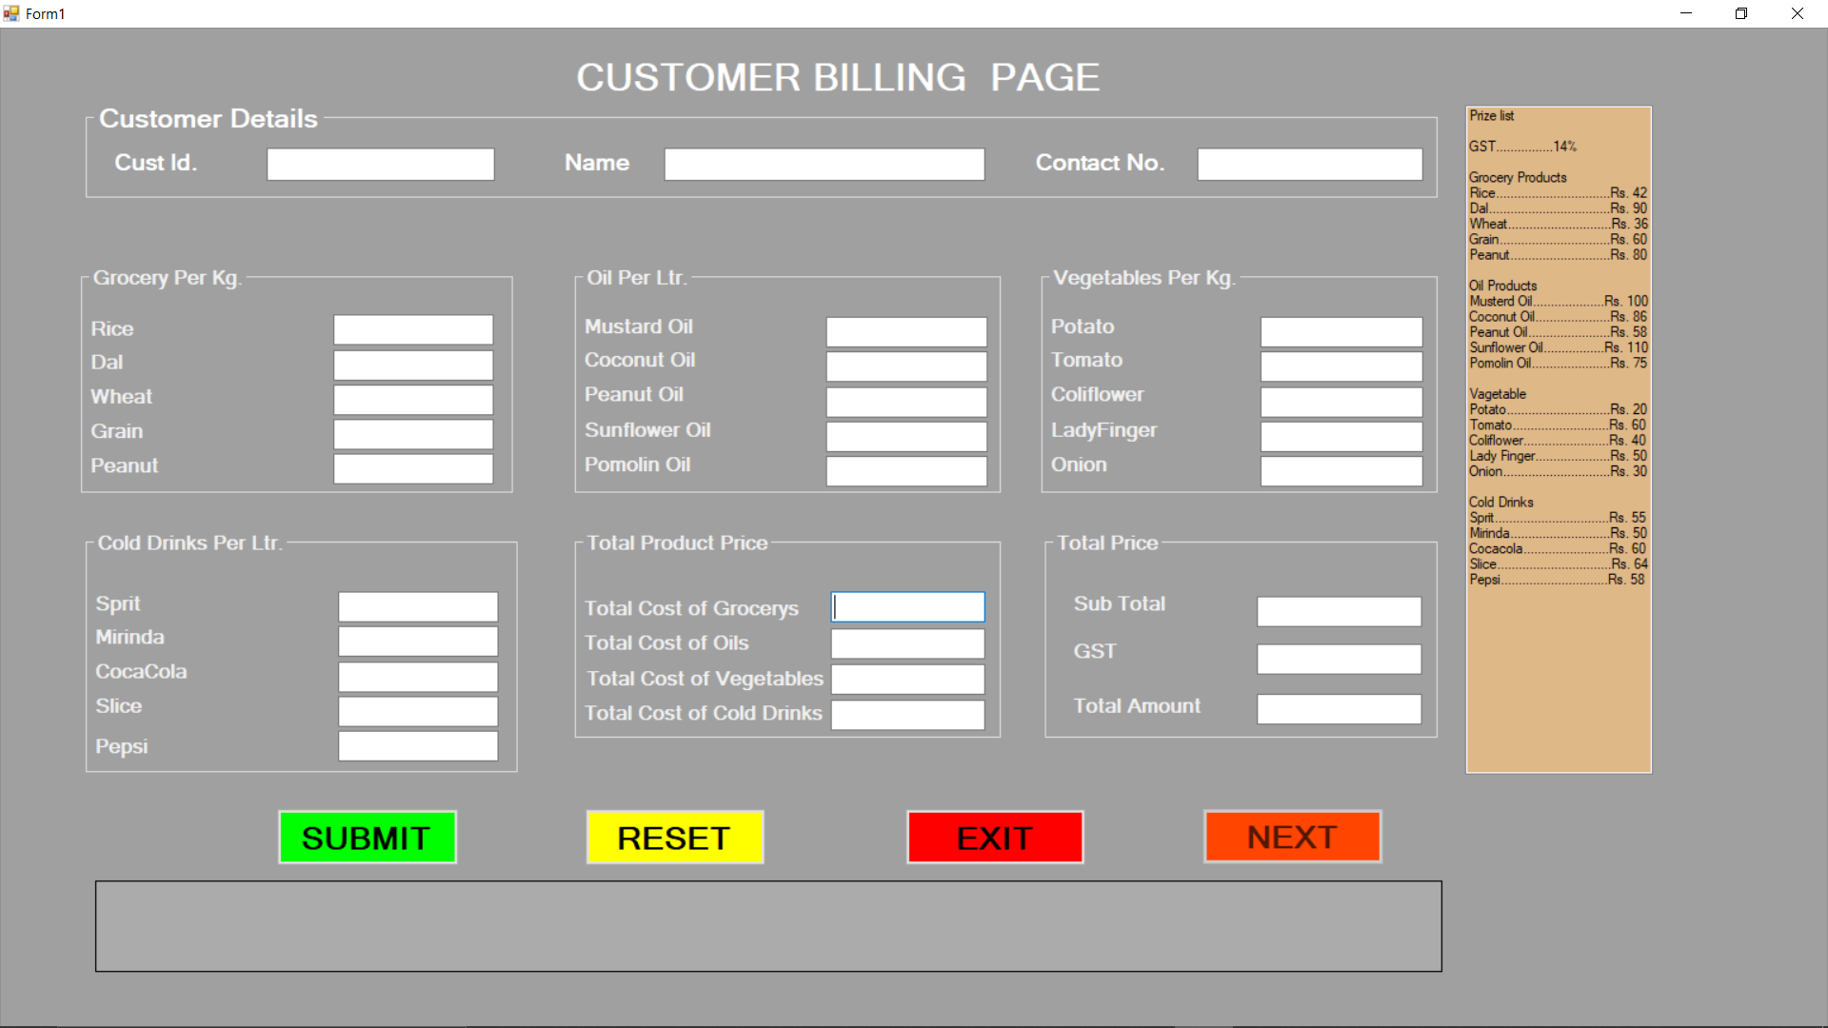

Slide 9
CUSTOMER BILLING HOME PAGE
The Home Page Content following fields:
Customer id
Name
Contact Number
Grocery, oil, vegetable & cold drinks
The Home Page Buttons:
Submit
Reset
Exit
Next

Slide 10
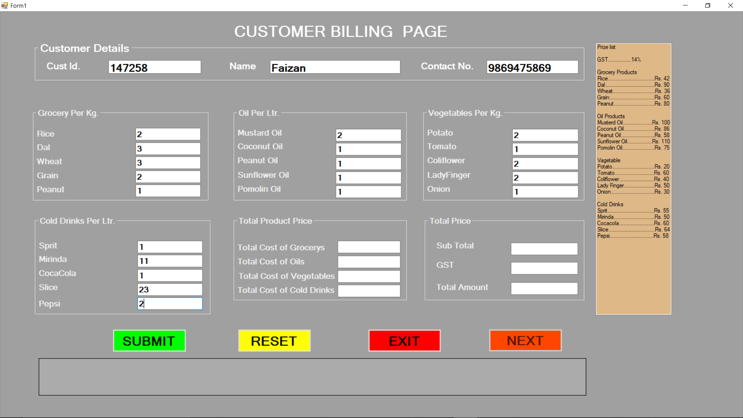

Slide 11
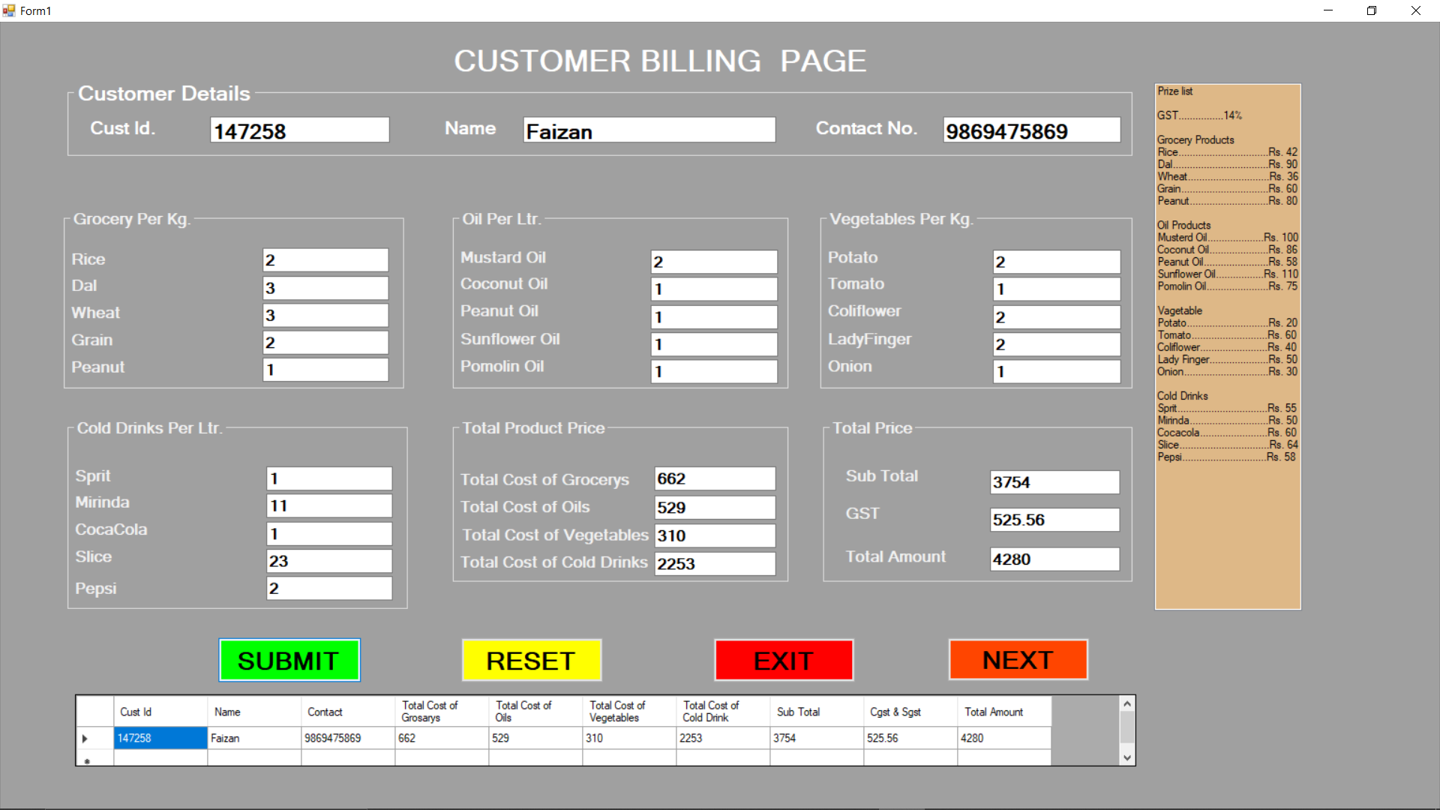

Slide 12
Submit entry
Total Product Price following fields:
Grocery total
Oil total
Vegetable total
Cold drinks total
Total Price :
Sub total
GST
Total Amt

Slide 13
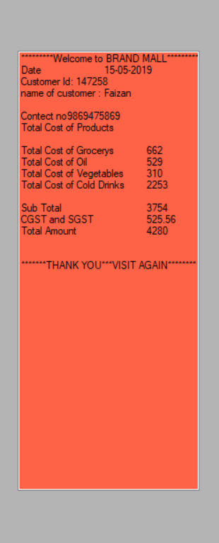
Customer Billing System
It’s a windows application designed to help staff or admin to maintain & organize customer system. Our application is easy to use for both beginners & advanced users.
An attractive user interface, combined with strong insertion & deletion capabilities. It can also calculate GST amount on every product.
Generate bill module – generate bill of purchased products.

Slide 14
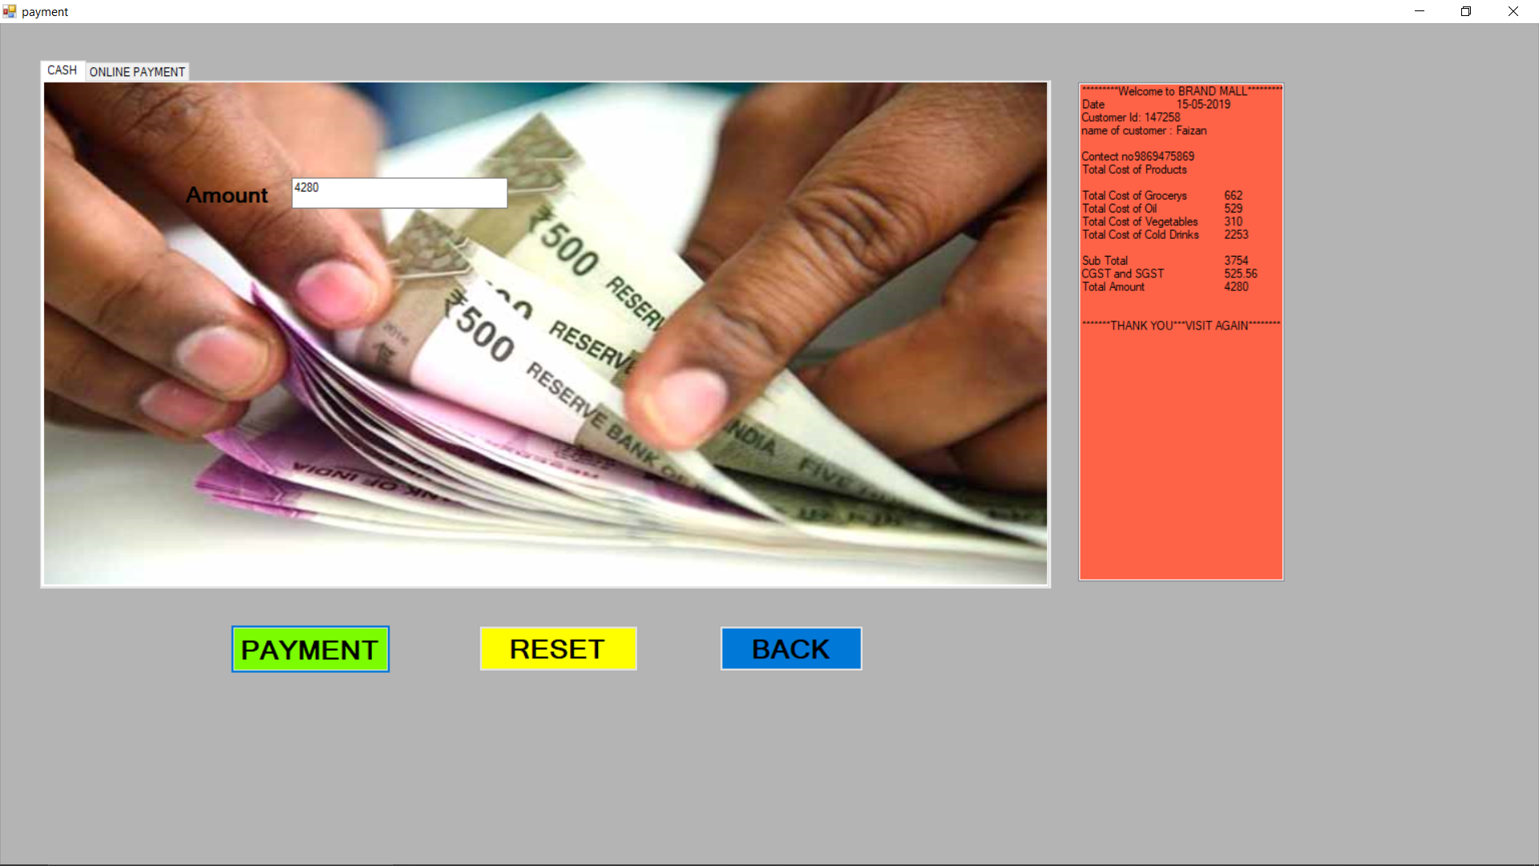
CASH PAYMENT PAGE

Slide 15
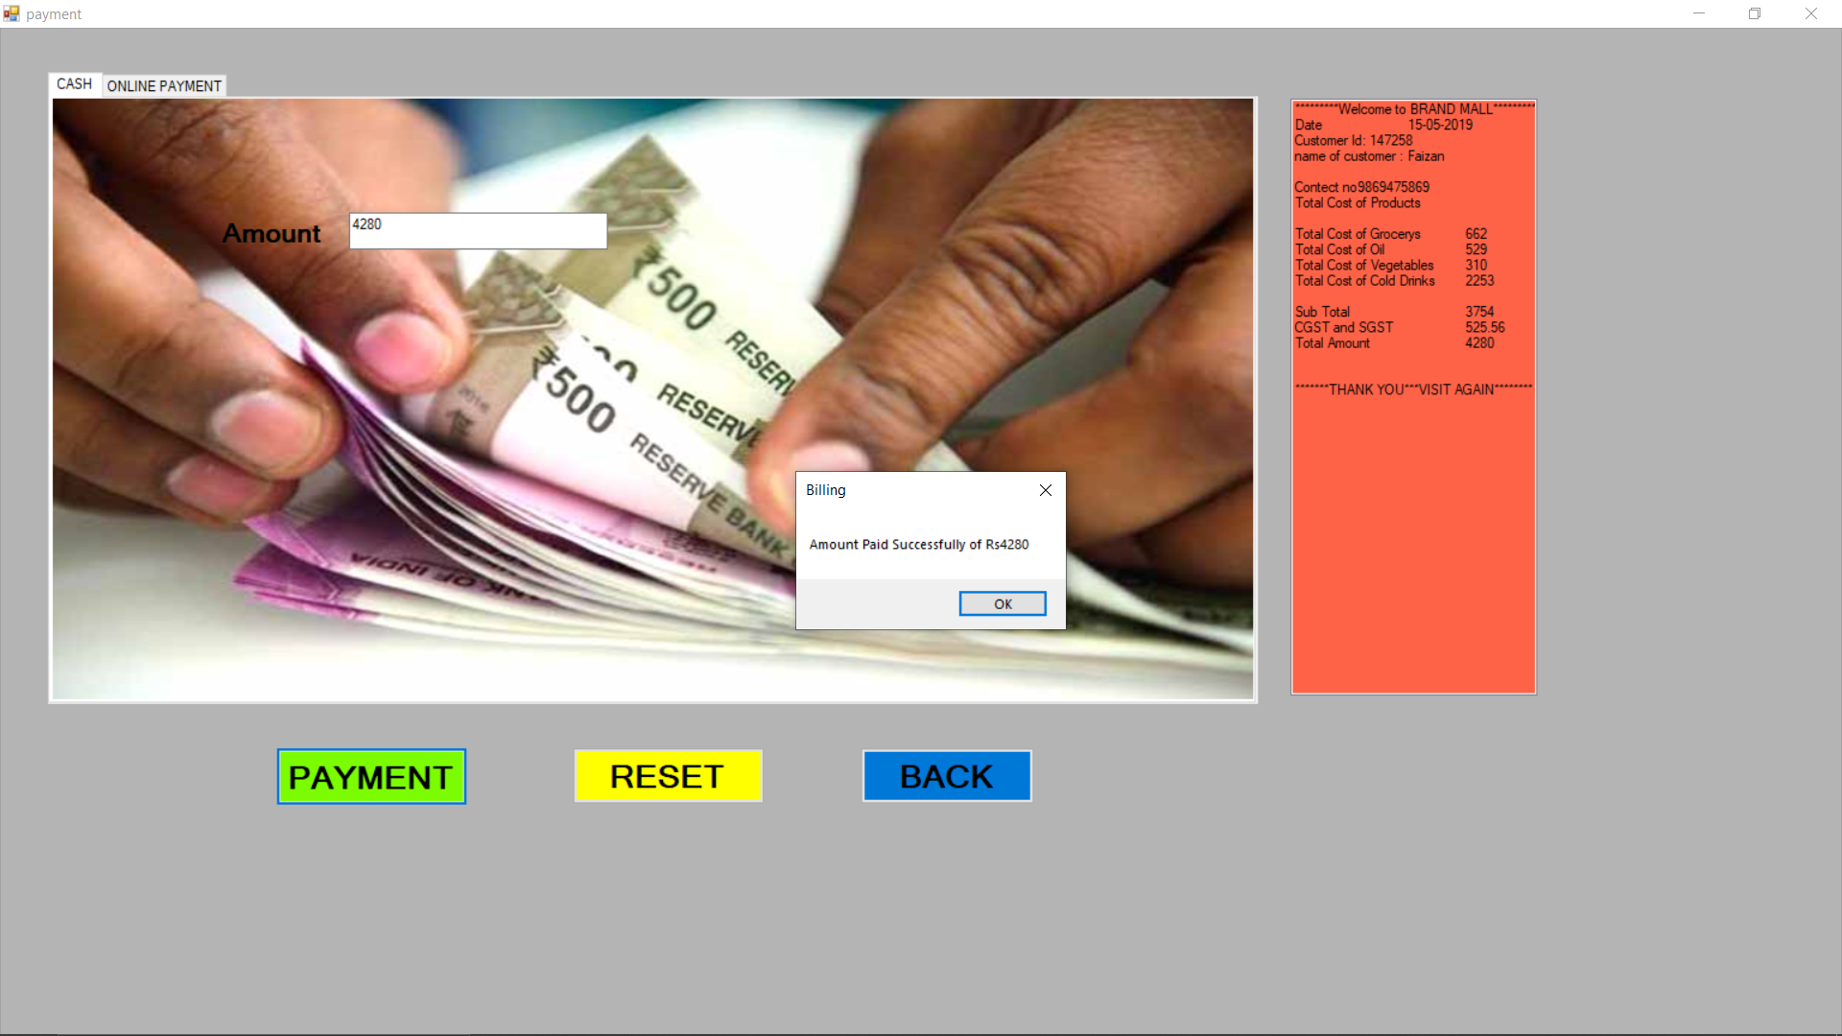
Amount Paid Cash Successfully

Slide 16
REFERENCE
PLACES I TOOK HELP TO BUILD THE PROJECT
INTERNET
YOUTUBE.COM
FRIENDS
COLLEGE FACULTY’S

Slide 17
THANK YOU
THE END

